Slide 1

CLINIC
MANAGEMENT
SYSTEM
FUNDAMENTALS OF DATABASES
Name
Ahmed wael
Bishoy akram
Peter emad
Salma gaber
ID 221001655
221001760
221000484
231000937

Slide 2
The Clinic Management System is designed to manage patients,
appointments, clinics, doctors, and departments.
It simplifies the process of scheduling, storing patient
information, and tracking medical history.
Core modules include: Patient, Appointment, Doctor, Clinic,
Department.
Project Overviewpurpose

Slide 3
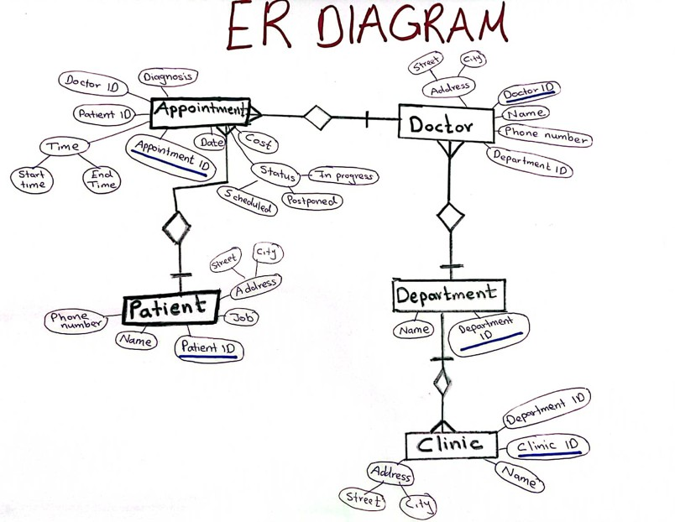
ER Diagram
One Department has many Clinics One Department has many Doctors One Clinic belongs to one Department One Doctor has many Appointments One Patient has many Appointments

Slide 4
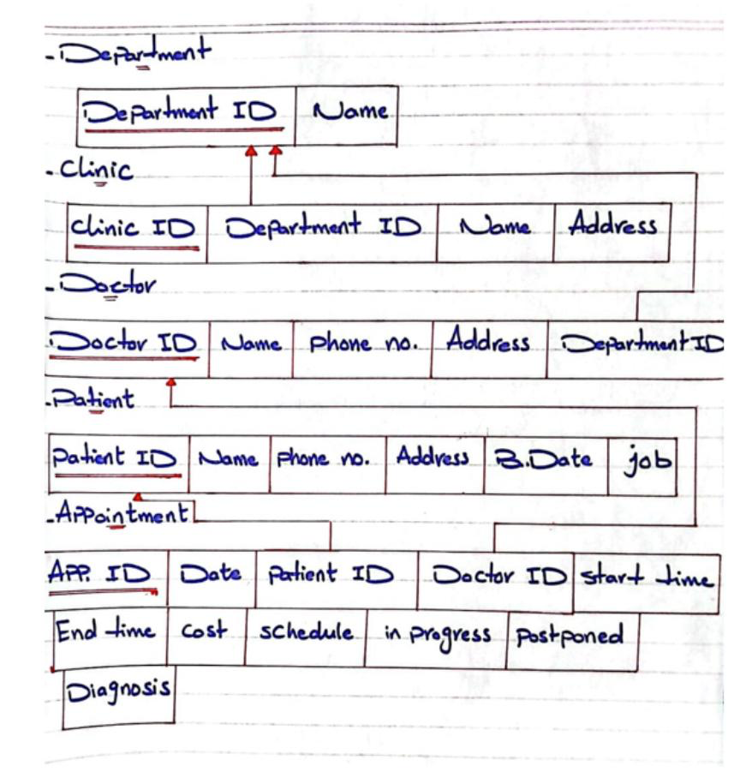
The schema

Slide 5
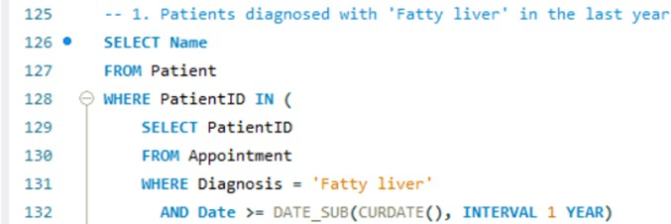
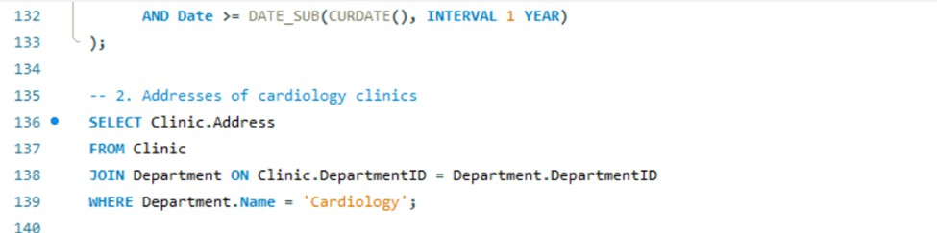
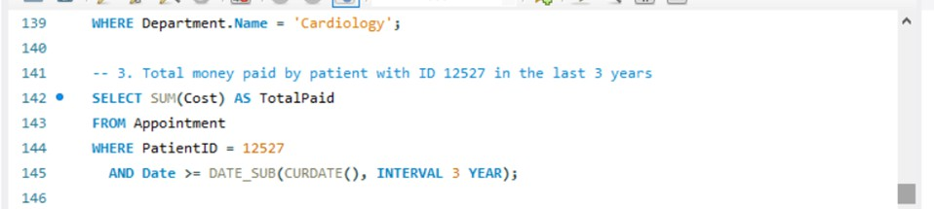
Sample SQL Queries
List the name of patients diagnosed with fatty liver in the last year:
List the addresses of cardiology clinics
List the total money paid by patient 12527 in the last 3 years:

Slide 6
Thank you very much!

